Slide 1

The Power of Agricultural Data: Insights for Sustainable Farming
SREELAKSHMI P G
(DATA ANALYTICS)

Slide 2

Introduction
This presentation explores the potential of a vast agricultural dataset, containing 88,858 records, to drive sustainable farming practices.
Data Richness
The dataset encompasses a wealth of information, providing a comprehensive view of agricultural practices and their impact.
Data Variety
It includes details like crop type, soil conditions, pesticide usage, insect counts, and crop damage levels.

Slide 3
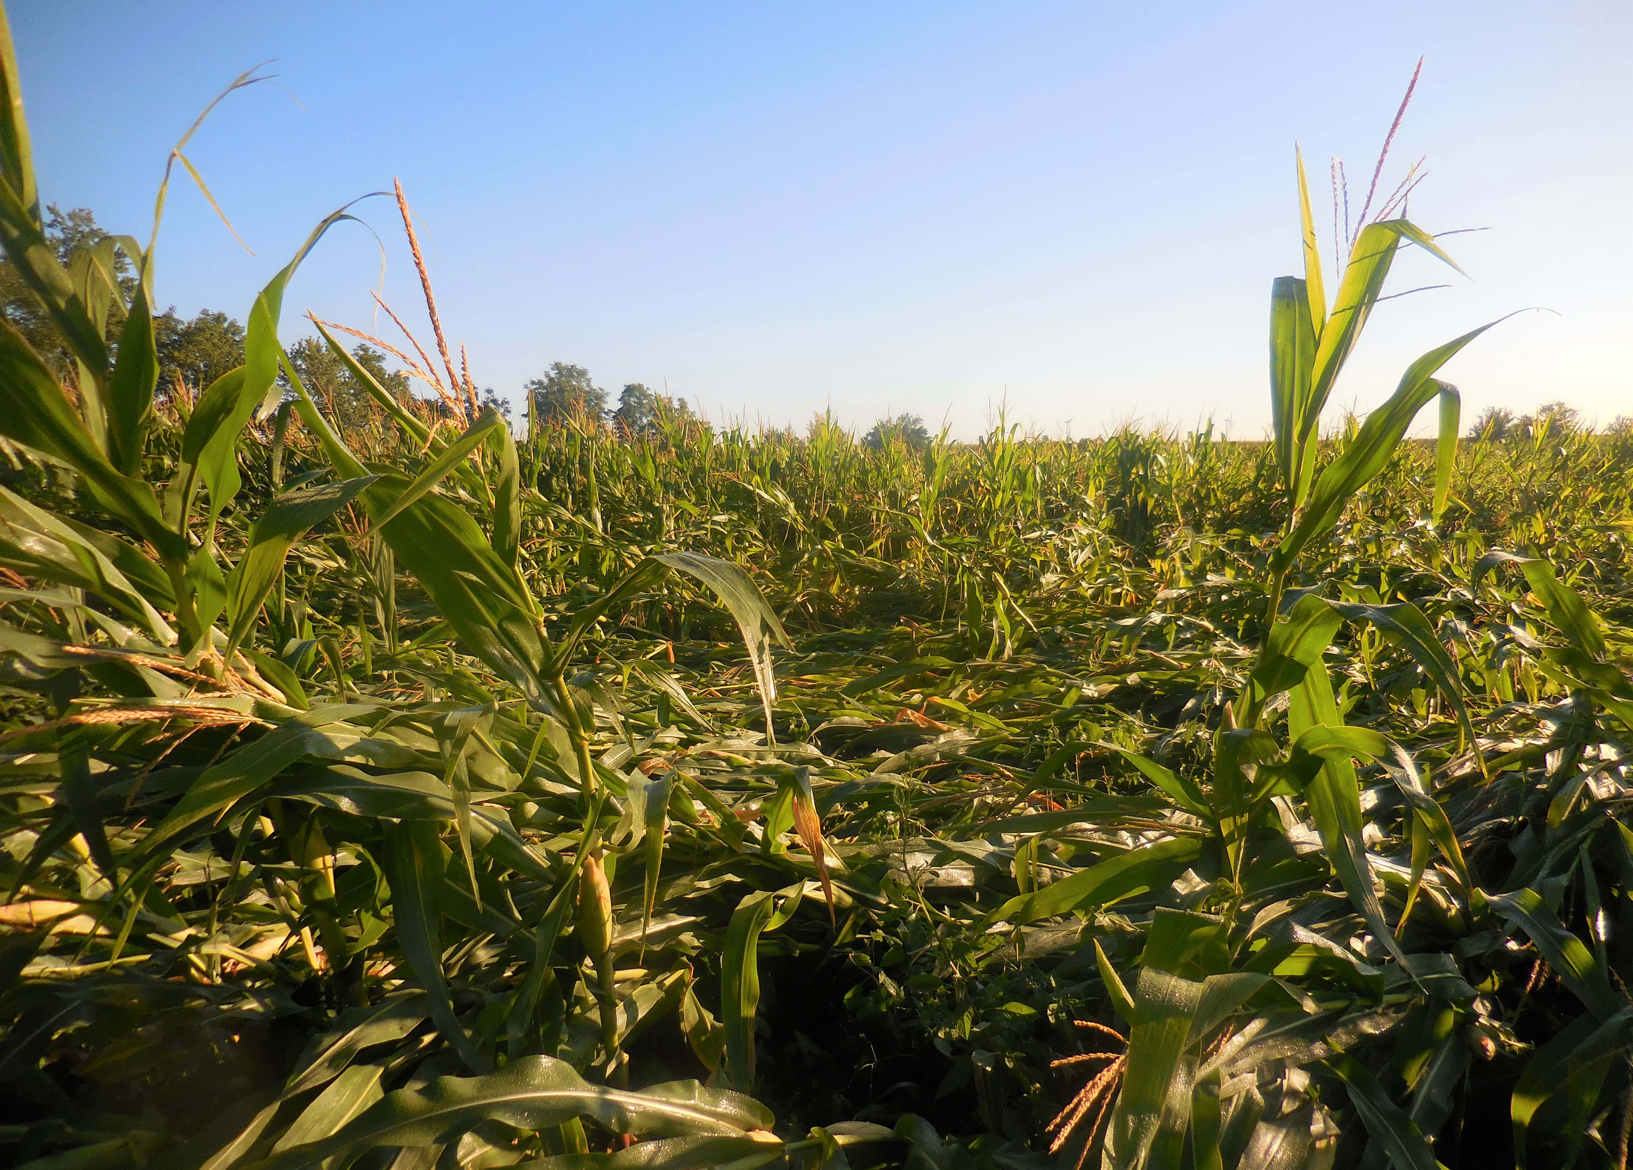
Objectives
To predict the extent of crop damage based on given features to support risk assessment, resource allocation, and better crop management decisions.
To create a Streamlit web application to predict the extent of crop damage based on agricultural data.

Slide 4






Key Data Dimensions: Crop, Soil, Pesticides, Insects, Seasons, Damage
Crop Type
Soil Type
Pesticide Usage
Insect Counts
Provides insights into the diversity of crops grown and their specific requirements.
Reveals the composition and properties of the soil, affecting crop growth and nutrient absorption.
Offers data on the types and amounts of pesticides applied, influencing crop health and environmental impact.
Identifies insect populations, indicating potential pest outbreaks and the need for control measures.
Seasonal Effects
Crop Damage Levels
Captures the influence of different seasons on crop growth and yield, revealing seasonal patterns and challenges.
Indicates the extent of crop damage from pests, diseases, and other factors, highlighting areas for improvement.

Slide 5
Exploring Farming Practices and Crop Health
Data Analysis
1
Data analysis techniques can be used to study the relationships between farming practices and crop health outcomes.
2
Correlation
Investigating the correlations between factors like pesticide usage, insect counts, and crop damage levels.
Impact Assessment
3
Evaluating the impact of different farming practices on crop yields, pest control effectiveness, and overall sustainability.

Slide 6




Identifying Trends and Patterns in the Data
Data Mining
Data mining algorithms can uncover hidden trends and patterns in the dataset, revealing insights not immediately apparent.
Predictive Modeling
Developing predictive models to forecast future crop yields, pest infestations, and potential risks based on historical data.
Data-Driven Insights
Uncovering insights into factors influencing crop health, pest control effectiveness, and resource optimization.

Slide 7
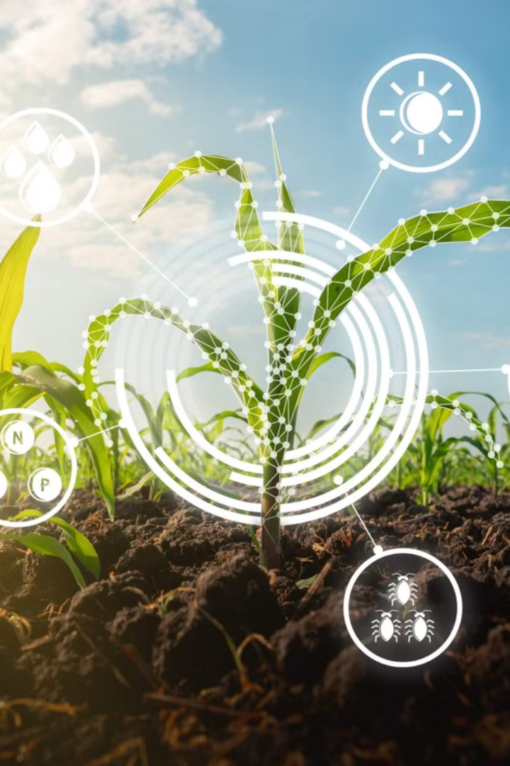
Leveraging Insights for Improved Decision-Making
1
2
Precision Agriculture
Pest Management
Data-driven insights can guide precision agriculture practices, optimizing resource allocation and improving efficiency.
Analyzing insect populations and damage patterns can inform targeted pest management strategies, reducing chemical reliance.
3
Sustainable Practices
Identifying sustainable farming practices through data analysis, promoting environmentally responsible agriculture.

Slide 8
Conclusion and Next Steps
By comparison it was discovered that Gradient Boost Classifier gives the best accuracy score.
Model | Test_acc (%) | Train_acc (%)
KNN Classifier | 83.402 | 85.977
Random Forest Classifier | 82.272 | 98.83
Ada Boost Classifier | 84.112 | 84.565
Gradient Boost Classifier | 84.429 | 85.083
This agricultural dataset offers invaluable insights for sustainable farming practices. The data reveals key relationships between farming techniques and crop health, enabling more informed decisions.
Moving forward, we can apply these findings to optimize resource use, encourage eco-friendly methods, and ultimately create a more sustainable agricultural future.

Slide 9
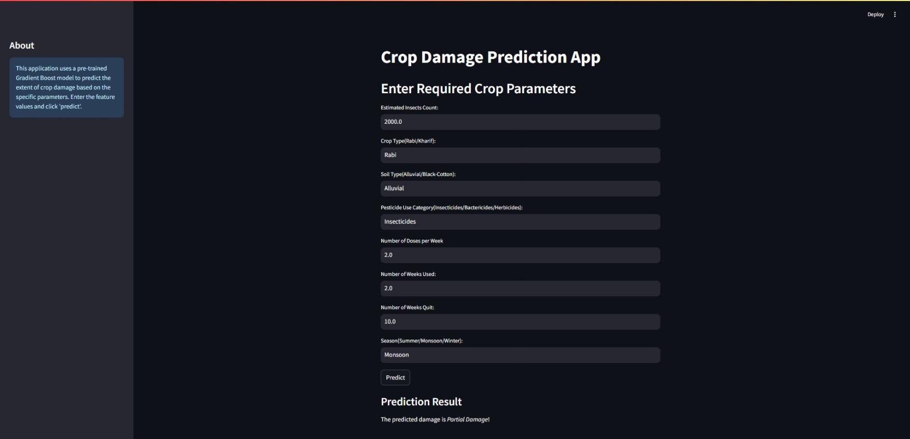
Screenshot of App

Slide 10
Data Sources and Methodology
Data Sources
Methodology
Data preprocessing and EDA was done with the help of Jupyter notebook and various python libraries like pandas, Numpy, Matplotlib, Seaborn to name a few.
With the help of Streamlit an interactive web application was created to predict the extent of crop damage.
The dataset utilized in this project has been sourced from a popular online platform known as Kaggle, which hosts a wide variety of datasets for data analysis and machine learning purposes.

Slide 11

Thank You…

